Slide 1


EXPLORING nature THROUGH {rvest}
DONALD SZLOSEK
Notes:
Photo by Joshua Earle on Unsplash

Slide 2
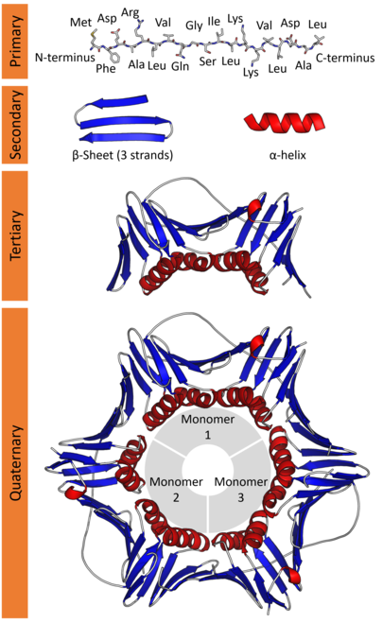
WHY

Slide 3

WHY

Slide 4


THE TOOLS
{rvest}
Selector gadget
Tidyverse functions

Slide 5
{rvest}
{rvest} is a websraping package in R for extracting data from html and xml websites.

Slide 6
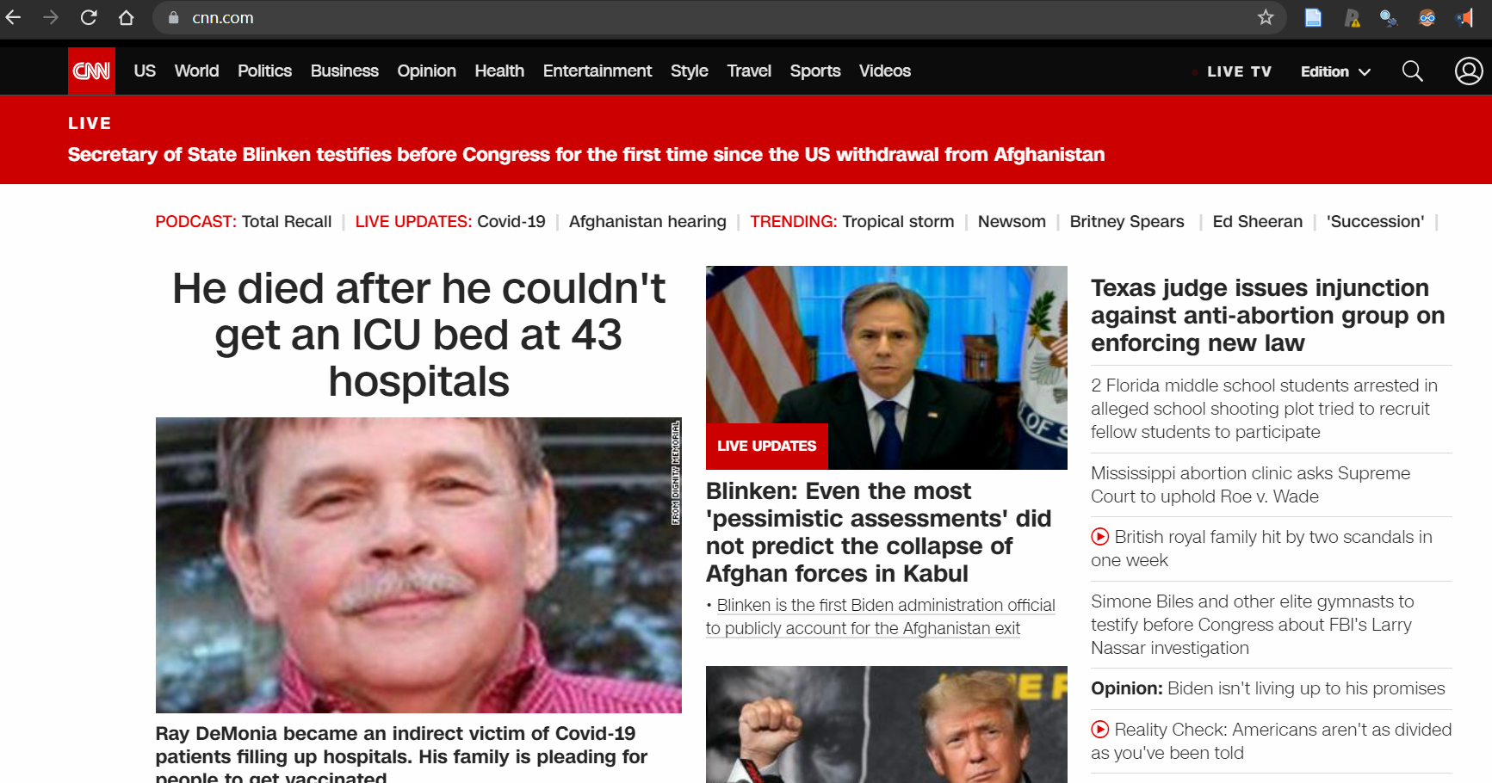
{rvest}
{rvest} is a websraping package in R for extracting from html and xml websites.
Explore Website of Interest

Slide 7
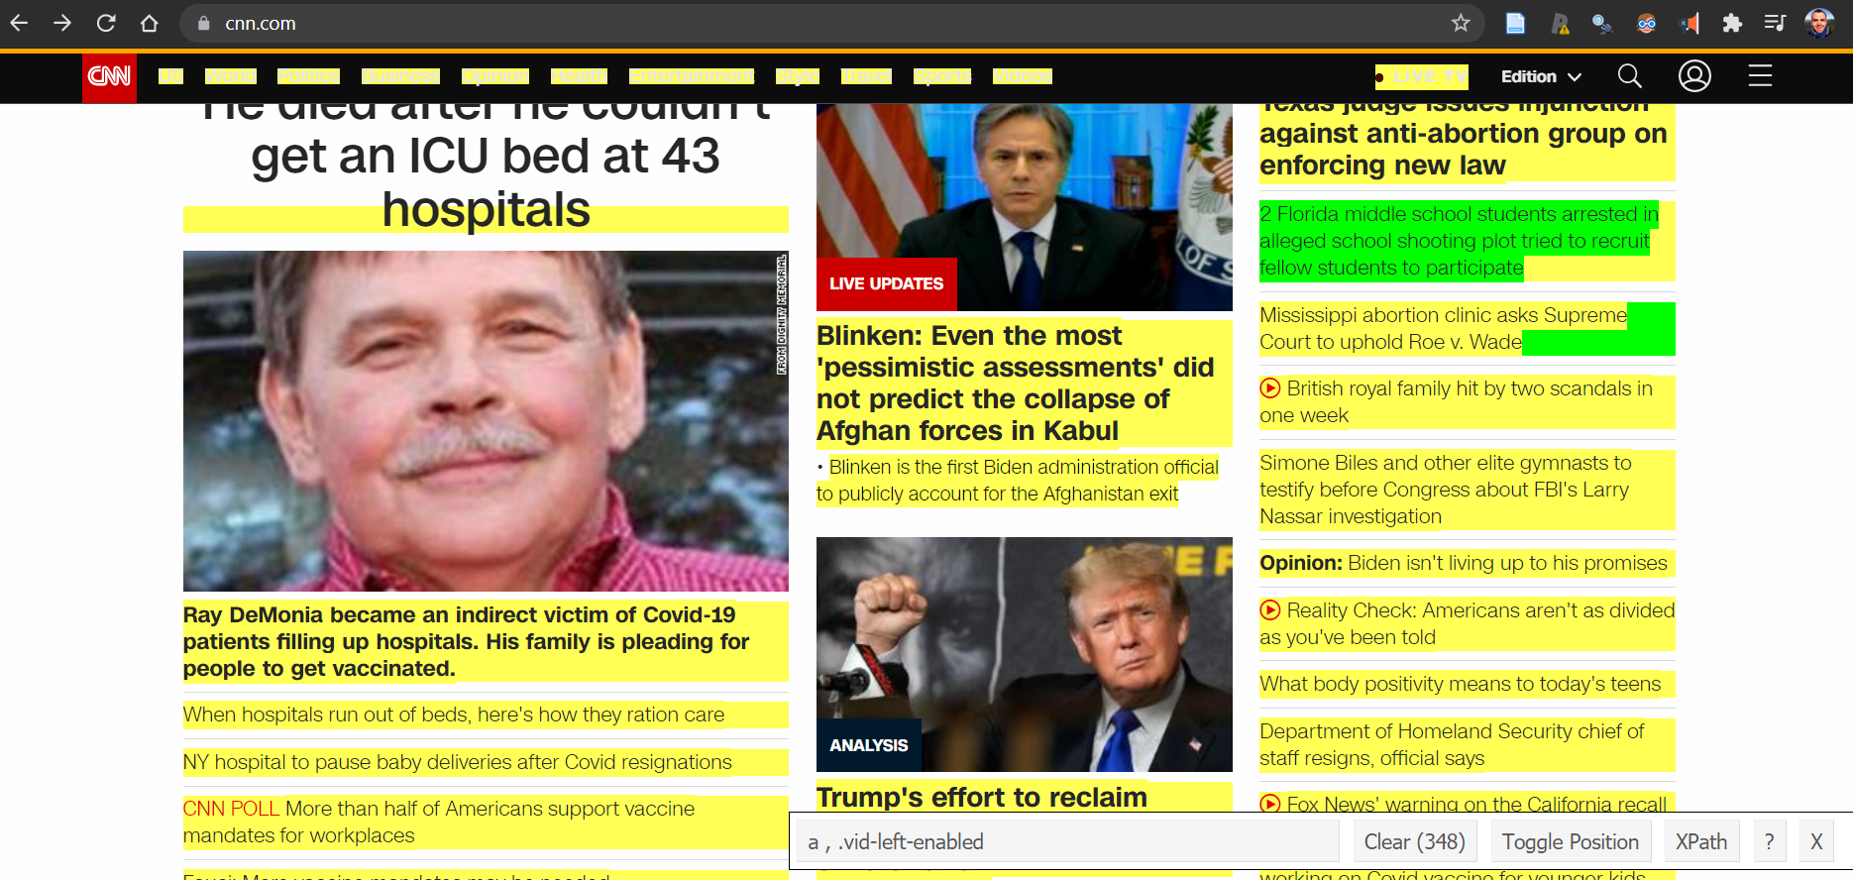
{rvest}
{rvest} is a websraping package in R for extracting from html and xml websites.
Explore Website of Interest
Understand Site Structure

Slide 8
{rvest}
{rvest} is a websraping package in R for extracting from html and xml websites.
Explore Website of Interest
Understand Site Structure
Extract Relevant Information
Texas judge issues injunction against ……
2 Florida middle school students arrested in …..
Supreme Court to uphold ……
British royal family hit ……

Slide 9
SITE EXPLORATION

Slide 10
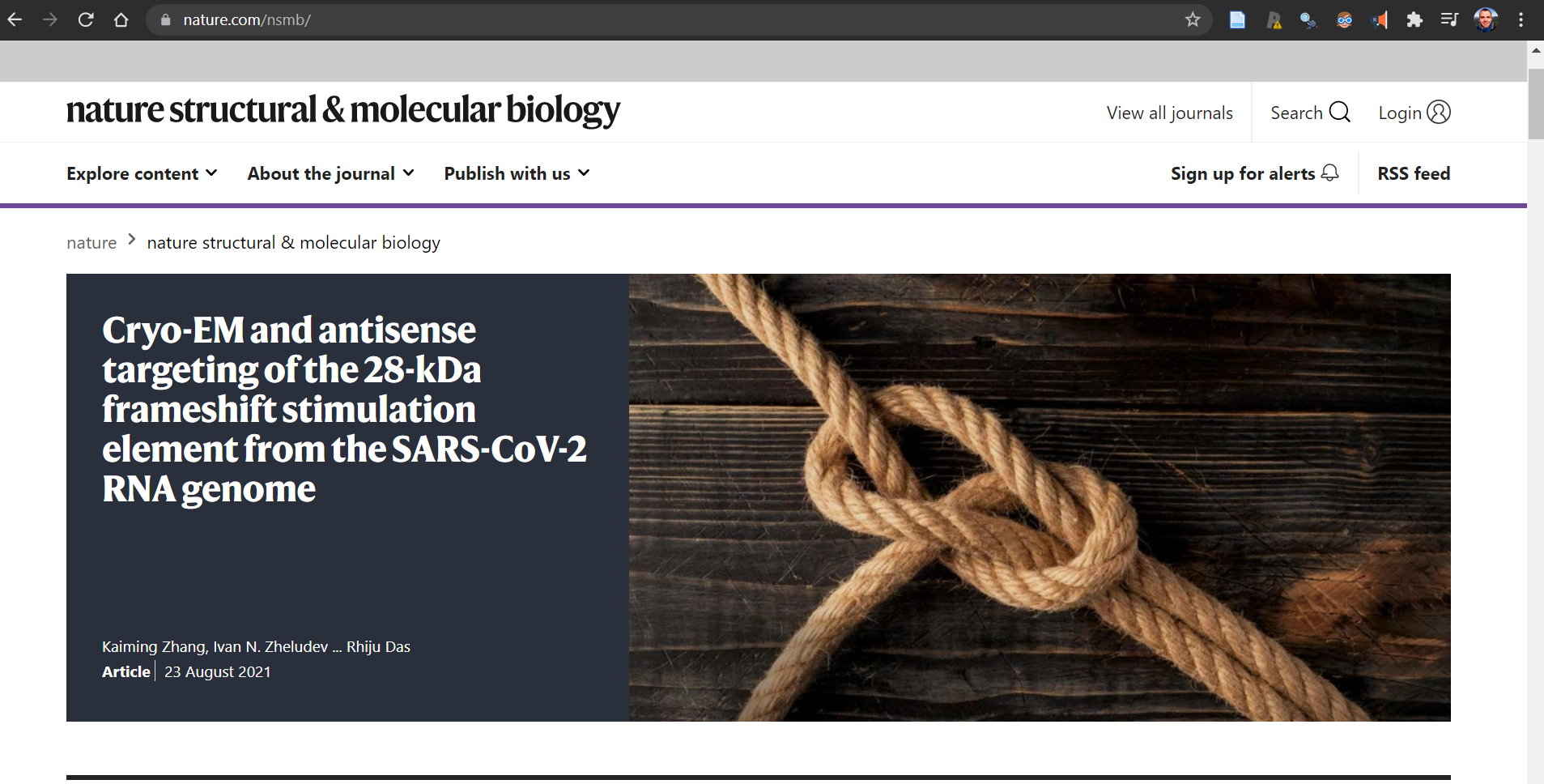
Exploration

Slide 11
Exploration
https://www.nature.com/nsmb/

Slide 12
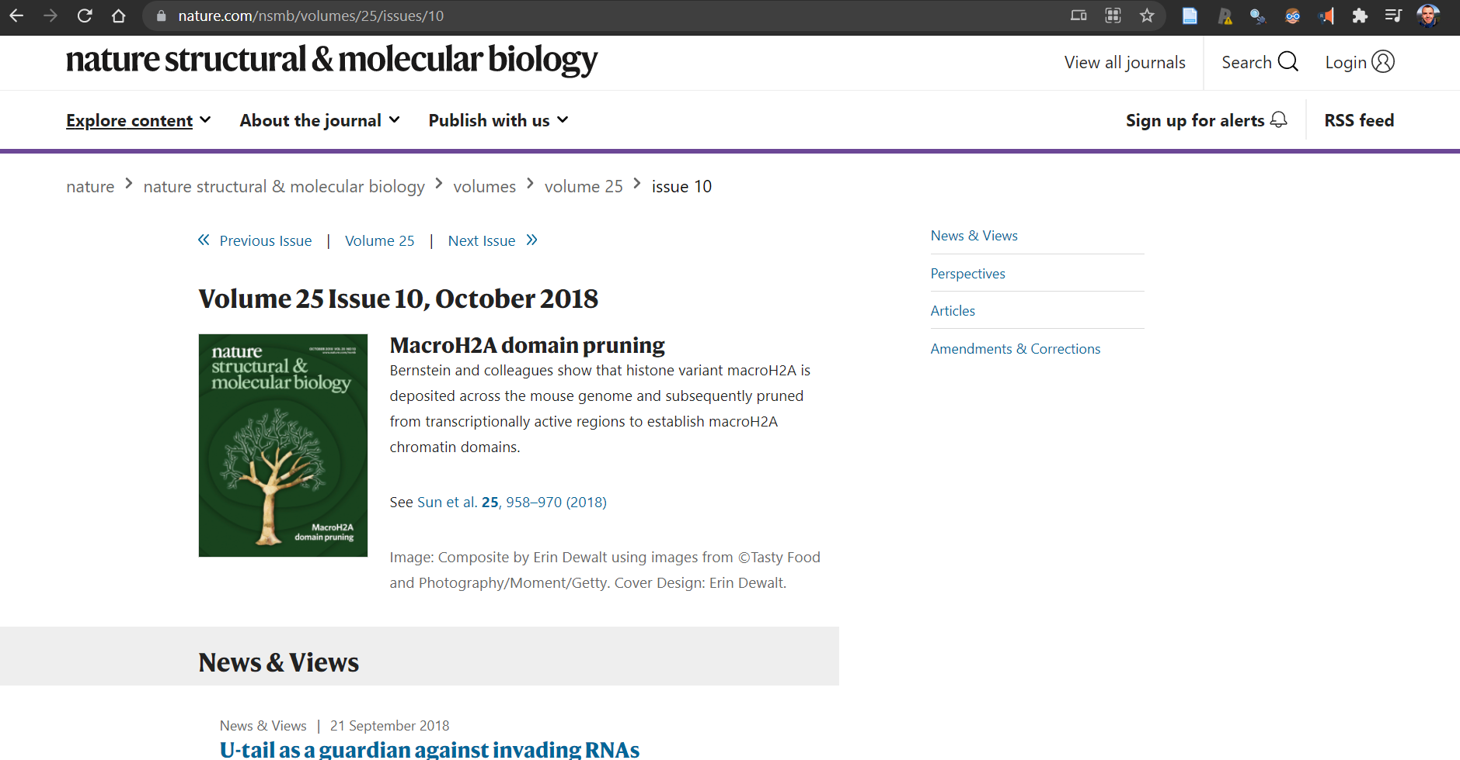
Exploration
https://www.nature.com/nsmb/volumes/25/issues/10

Slide 13
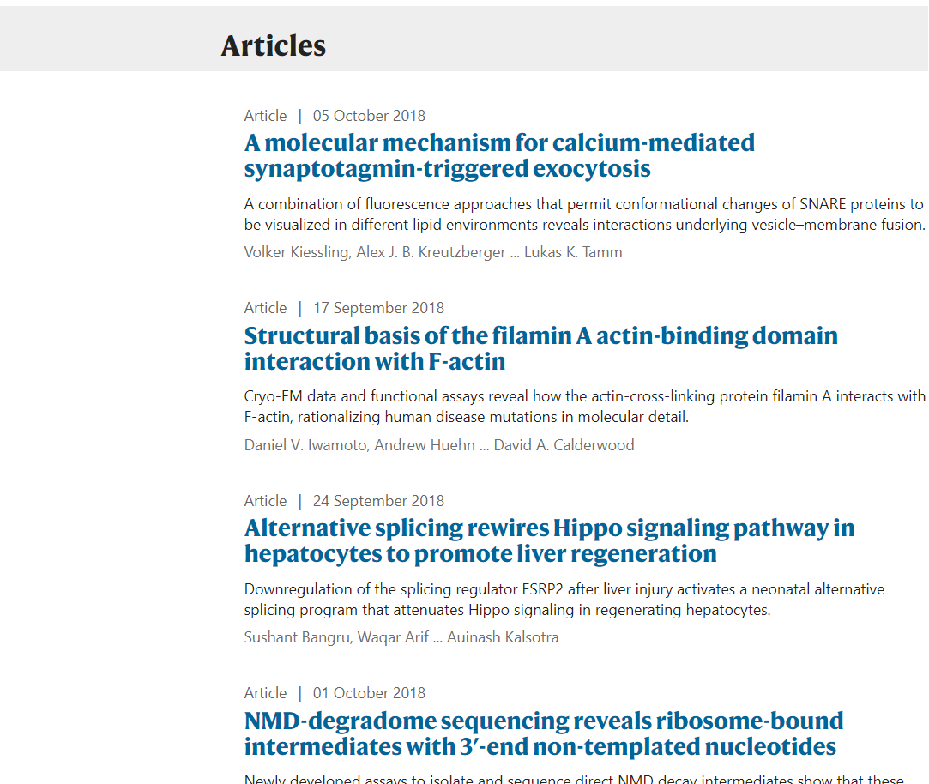
Exploration
https://www.nature.com/nsmb/volumes/25/issues/10

Slide 14
Exploration
https://www.nature.com/nsmb/volumes/25/issues/10

Slide 15
Looking at the Structure
Volume #
Issue #
https://www.nature.com/nsmb/volumes/25/issues/10
Journal ID

Slide 16
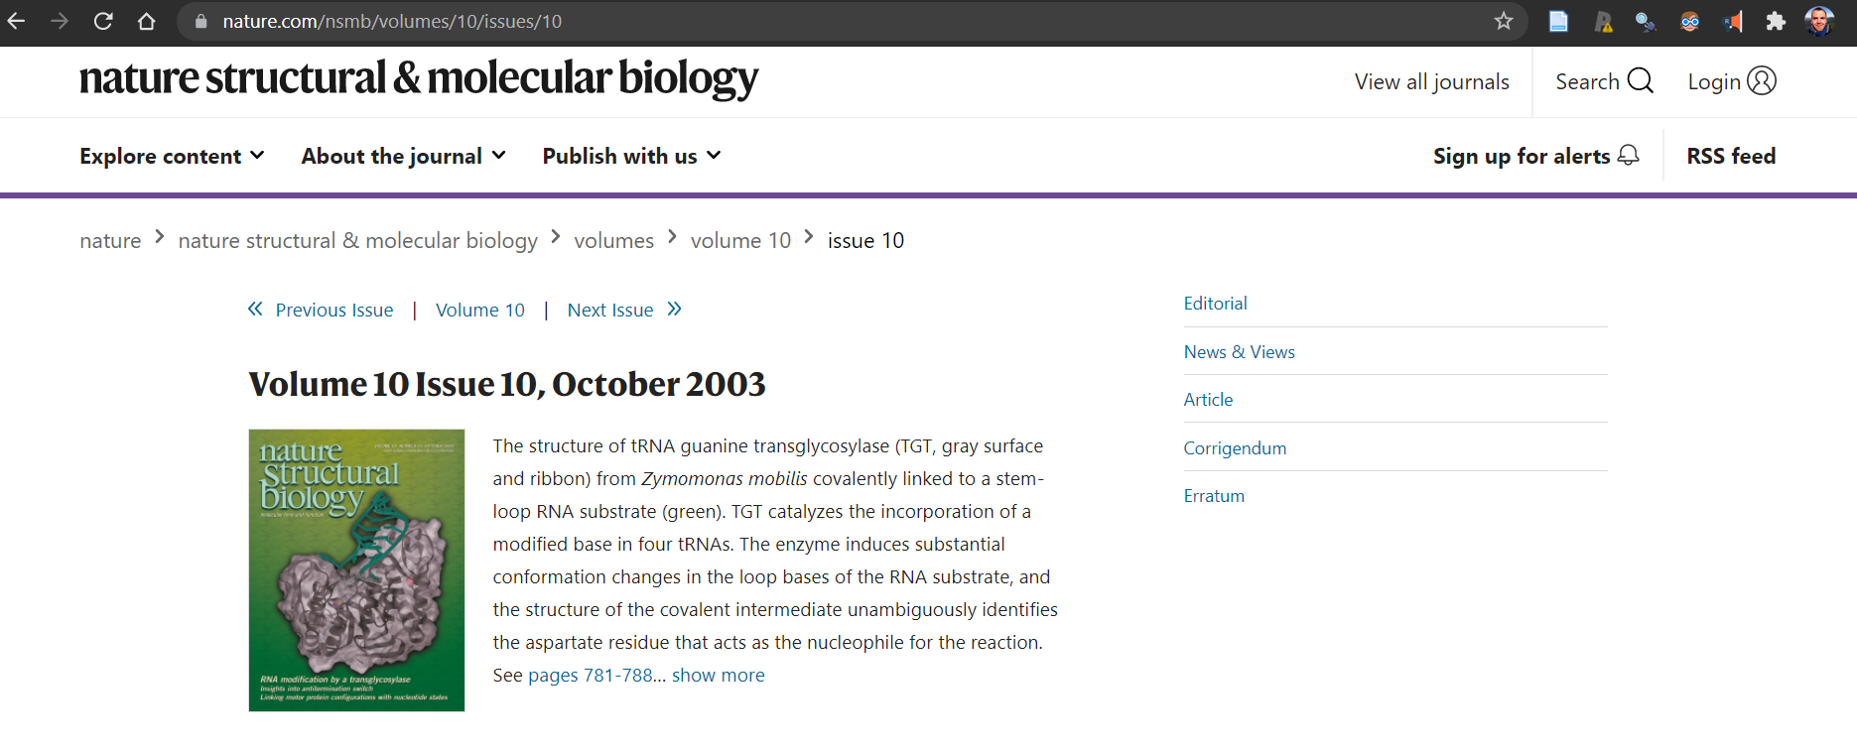
Changing Volume
https://www.nature.com/nsmb/volumes/10/issues/10

Slide 17
THE CODE

Slide 18
Websrapping with {rvest}
Code:
Output:
rvest::read_html("https://www.nature.com/nsmb/volumes/25/issues/10")
{html_document}
<html lang="en" class="grade-c">
[1] <head>\n<meta http-equiv="Content-Type" content="text/html; charset=UTF-8">\n<title>Volume 25 Issue 10, October 2018</title>\n<link rel="preload" href="/stat ...
[2] <body class="issue-page background-white">\n<!--<![endif]-->\n\n<noscript><iframe src="https://www.googletagmanager.com/ns.html?id=GTM-NWDMT9Q" height="0" wi ...
Notes:
Read_html <- imported FROM xml2 package-- An XML document. HTML is normalised to valid XML - this may not be exactly the same transformation performed by the browser, but it's a reasonable approximation.

Slide 19
Websrapping with {rvest}
Code:
Output:
nsmb <- rvest::read_html("https://www. nature.com/nsmb/volumes/25/issues/10")
nsmb %>% rvest::html_text()
[1] "Volume 25 Issue 10, October 2018\n dataLayer = [{\"content\":{\"category\":{\"contentType\":null,\"legacy\":null},\"article\":null,\"attributes\":{\"cms\":null,\"deliveryPlatform\":null,\"copyright\":null},\"contentInfo\":null,\"journal\":{\"pcode\":\"nsmb\",\"title\":\"Nature Structural & Molecular Biology\",\"volume\":null,\"issue\":null},\"authorization\":{\"status\":true},\"features\":[],\"collection\":null},\"page\":{\"category\":{\"pageType\":\"issue\"},\"attributes\":{\"template\":\"mosaic\",\"featureFlags\":[{\"name\":\"ab_test_highlight_supp_info\",\"active\":false},{\"name\":\"nature-oa-paywall\",\"active\":true},{\"name\":\"nature-onwards-journey\",\"active\":true}],\"testGroup\":null},\"search\":null},\"privacy\":{},\"version\":\"1.0.0\",\"product\":null,\"session\":null,\"user\":null,\"backHalfContent\":false,\"country\":\"US\",\"hasBody\":false,\"uneditedManuscript\":false,\"twitterId\":[\"o3xnx\",\"o43y9\",\"o3ef7\"]}];\n \n (function(w, d) {\n w.config = w.config || {};\n \n \n Volume 25 Issue 10, October 2018\n \n\n \n \n \n\n \n \n \n\n \n \n \n \n \n \n\n \n \n {……} MacroH2A domain pruning\nBernstein and colleagues show that histone variant macroH2A is deposited across the mouse genome and subsequently pruned from transcriptionally active regions to establish macroH2A chromatin domains.\nSee Sun et al. 25, 958–970 (2018) \n

Slide 20
Websrapping with {rvest}
Code:
Output:
nsmb <- rvest::read_html("https://www. nature.com/nsmb/volumes/25/issues/10")
nsmb %>% rvest::html_text()
[1] "Volume 25 Issue 10, October 2018\n dataLayer = [{\"content\":{\"category\":{\"contentType\":null,\"legacy\":null},\"article\":null,\"attributes\":{\"cms\":null,\"deliveryPlatform\":null,\"copyright\":null},\"contentInfo\":null,\"journal\":{\"pcode\":\"nsmb\",\"title\":\"Nature Structural & Molecular Biology\",\"volume\":null,\"issue\":null},\"authorization\":{\"status\":true},\"features\":[],\"collection\":null},\"page\":{\"category\":{\"pageType\":\"issue\"},\"attributes\":{\"template\":\"mosaic\",\"featureFlags\":[{\"name\":\"ab_test_highlight_supp_info\",\"active\":false},{\"name\":\"nature-oa-paywall\",\"active\":true},{\"name\":\"nature-onwards-journey\",\"active\":true}],\"testGroup\":null},\"search\":null},\"privacy\":{},\"version\":\"1.0.0\",\"product\":null,\"session\":null,\"user\":null,\"backHalfContent\":false,\"country\":\"US\",\"hasBody\":false,\"uneditedManuscript\":false,\"twitterId\":[\"o3xnx\",\"o43y9\",\"o3ef7\"]}];\n \n (function(w, d) {\n w.config = w.config || {};\n \n \n Volume 25 Issue 10, October 2018\n \n\n \n \n \n\n \n \n \n\n \n \n \n \n \n \n\n \n \n {……} MacroH2A domain pruning\nBernstein and colleagues show that histone variant macroH2A is deposited across the mouse genome and subsequently pruned from transcriptionally active regions to establish macroH2A chromatin domains.\nSee Sun et al. 25, 958–970 (2018) \n
Date
Title

Slide 21
Selector Gadget
Open source CSS selector
Chrome Extension

Slide 22
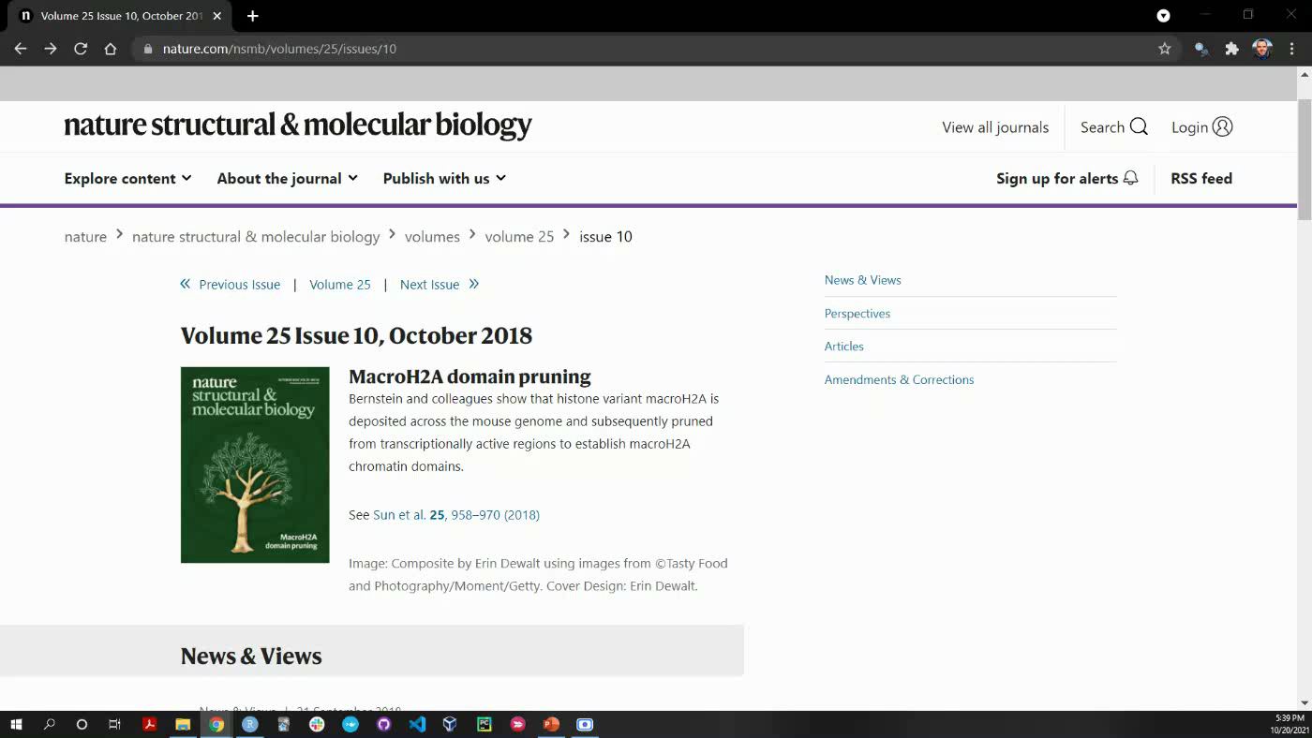

Slide 23
Websrapping with {rvest}
Code:
nsmb <- rvest::read_html("https://www. nature.com/nsmb/volumes/25/issues/10")
nsmb %>% rvest::html_node(
paste0(".pb30:nth-child(1) a")) %>%
rvest::html_text()

Slide 24
Websrapping with {rvest}
Code:
Output:
nsmb <- rvest::read_html("https://www. nature.com/nsmb/volumes/25/issues/10")
nsmb %>% rvest::html_node(
paste0(".pb30:nth-child(1) a")) %>%
rvest::html_text()
"\n U-tail as a guardian against invading RNAs"

Slide 25
Websrapping with {rvest}
Code:
Output:
nsmb <- rvest::read_html("https://www. nature.com/nsmb/volumes/25/issues/10")
nsmb %>% rvest::html_node(
paste0(".pb30:nth-child(2) a")) %>%
rvest::html_text()
"\n Structural basis of the filamin A actin-binding domain interaction with F-actin"

Slide 26

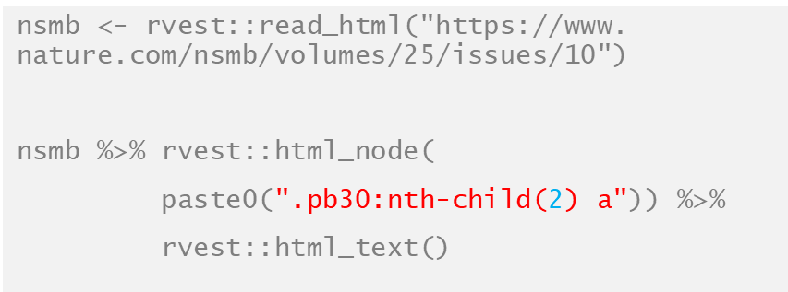
What do we know?
The general website structure
Extract Journal Titles

Slide 27
What do we know?
The general website structure
Extract Journal Titles
Functionalize!

Slide 28
Websrapping with {rvest}
Code:
subjournal_html_parser <- function(subjournal = "nsmb",volume = 1,issue = 1,child_node = 1) {
tmp_html <- rvest::read_html(paste0(
"https://www.nature.com/",subjournal,"/volumes/",volume,"/issues/",issue))
# parse html text
parsed_title <- tmp_html %>% rvest::html_node(
paste0(".pb30:nth-child(",child_node,") a")) %>%
rvest::html_text(.,trim = T)
parsed_title
}

Slide 29
Show Code

Slide 30
Now what…

Slide 31
Now what…
We have dataset
Notes:
We have this data set with the title and the date
Quote podcast with new York dataset data scientist

Slide 32

Now what…
We have dataset
Notes:
We have this data set with the title and the date
Quote podcast with new York dataset data scientist

Slide 33
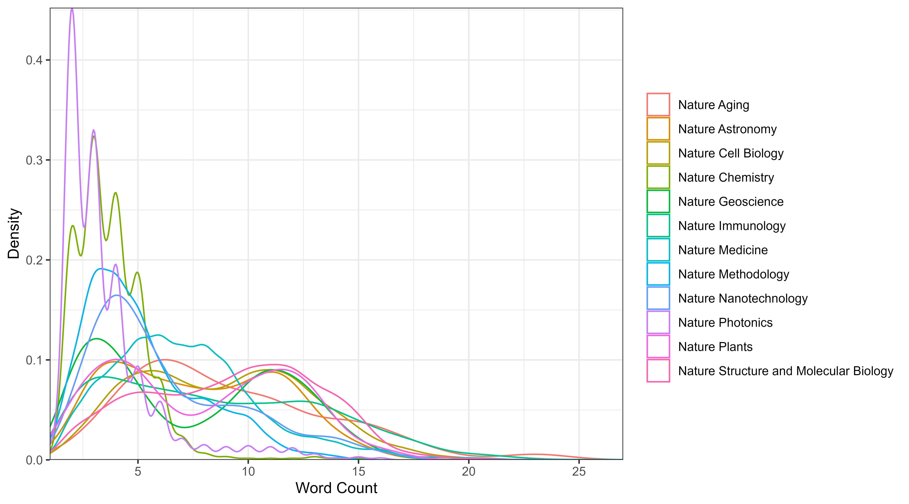

Slide 34
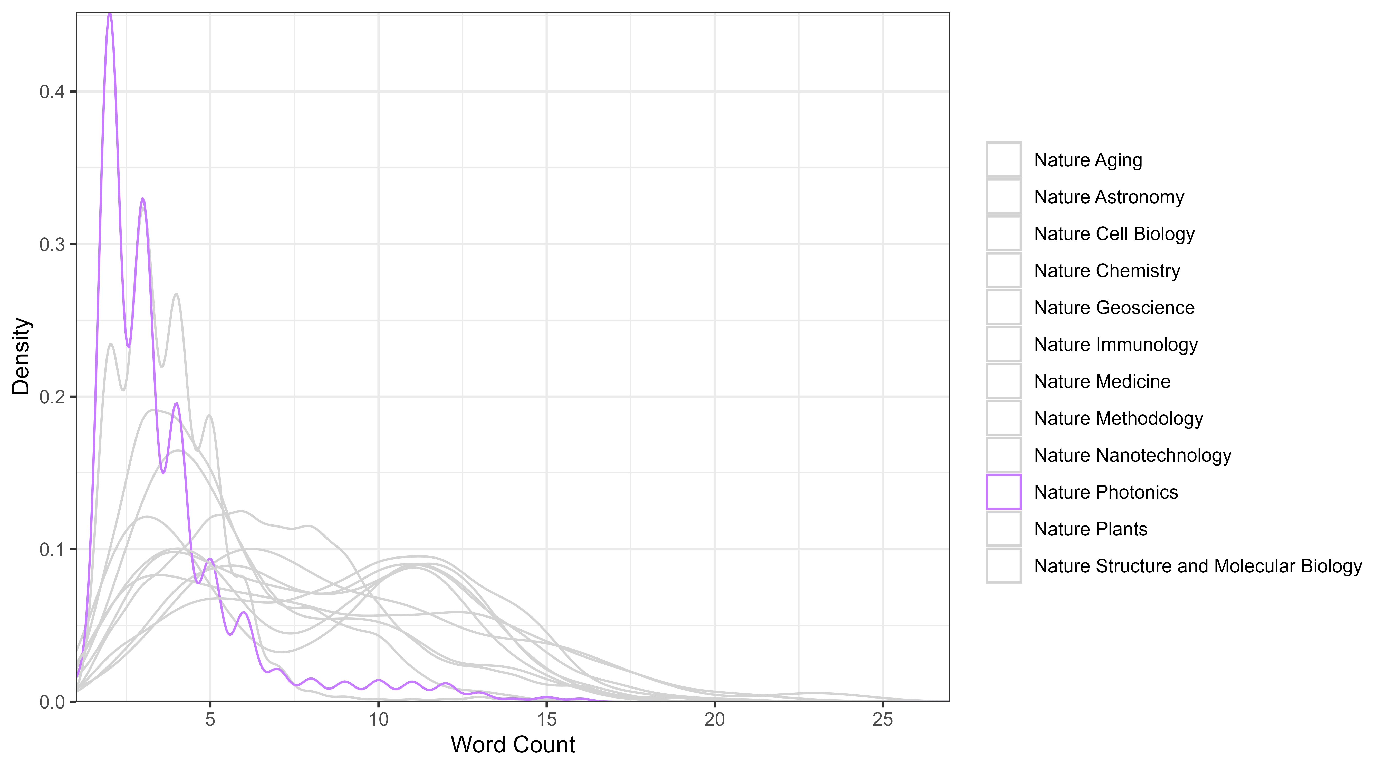

Slide 35
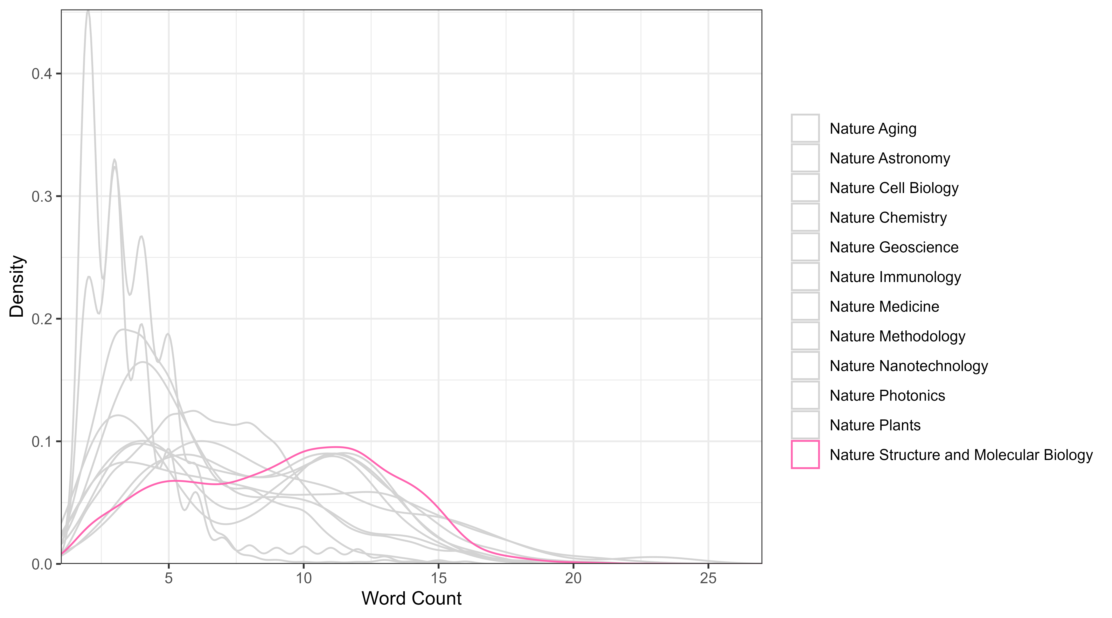

Slide 36
Back up

Slide 37
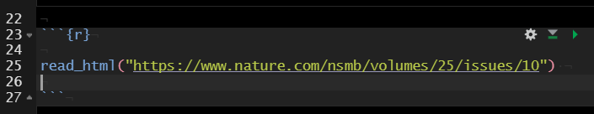
read_html("https://www.nature.com/nsmb/volumes/25/issues/10")
{html_document}
<html lang="en" class="grade-c">
[1] <head>\n<meta http-equiv="Content-Type" content="text/html; charset=UTF-8">\n<title>Volume 25 Issue 10, October 2018</title>\n<link rel="preload" href="/stat ...
[2] <body class="issue-page background-white">\n<!--<![endif]-->\n\n<noscript><iframe src="https://www.googletagmanager.com/ns.html?id=GTM-NWDMT9Q" height="0" wi ...

Slide 38
read_html("https://www.nature.com/nsmb/volumes/25/issues/10")
{html_document}
<html lang="en" class="grade-c">
[1] <head>\n<meta http-equiv="Content-Type" content="text/html; charset=UTF-8">\n<title>Volume 25 Issue 10, October 2018</title>\n<link rel="preload" href="/stat ...
[2] <body class="issue-page background-white">\n<!--<![endif]-->\n\n<noscript><iframe src="https://www.googletagmanager.com/ns.html?id=GTM-NWDMT9Q" height="0" wi ...

Slide 39

useR
Portland
https://www.meetup.com/Greater-Portland-useR-Group/

Slide 40
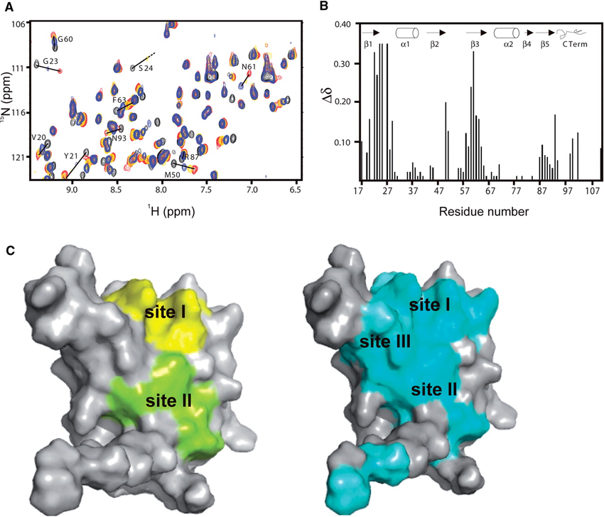
BACKGROUND
Notes:
https://www.researchgate.net/publication/41123044_Structure_of_the_Rna15_RRM-RNA_complex_reveals_the_molecular_basis_of_GU_specificity_in_transcriptional_3%27-end_processing_factors/figures?lo=1&utm_source=google&utm_medium=organic

Slide 41
